Slide 1
Heart Monitoring system
An IOT application for heart monitoring in real time.

Slide 2
Team : Ritika S Kalyanshetti (ECE) Sahana M (CSE) Vaishnavi P (BT) Guide : Prof. Samatha R Swamy Prof. Pushpa G

Slide 3
Why is Heart monitoring essential ?
Keeping track of your heart rate can give you insight into your fitness level, heart health and emotional health.
As we monitor our heart health, we can make lifestyle changes to reduce the risk of developing heart disease or to help manage the condition if it is already present.
Monitoring the heart can also help us to detect any underlying problems. Foe example, high blood pressure could be a sign of hormone problems or diabetes.
Monitoring the heart health has also proven to reduce stress levels.

Slide 4
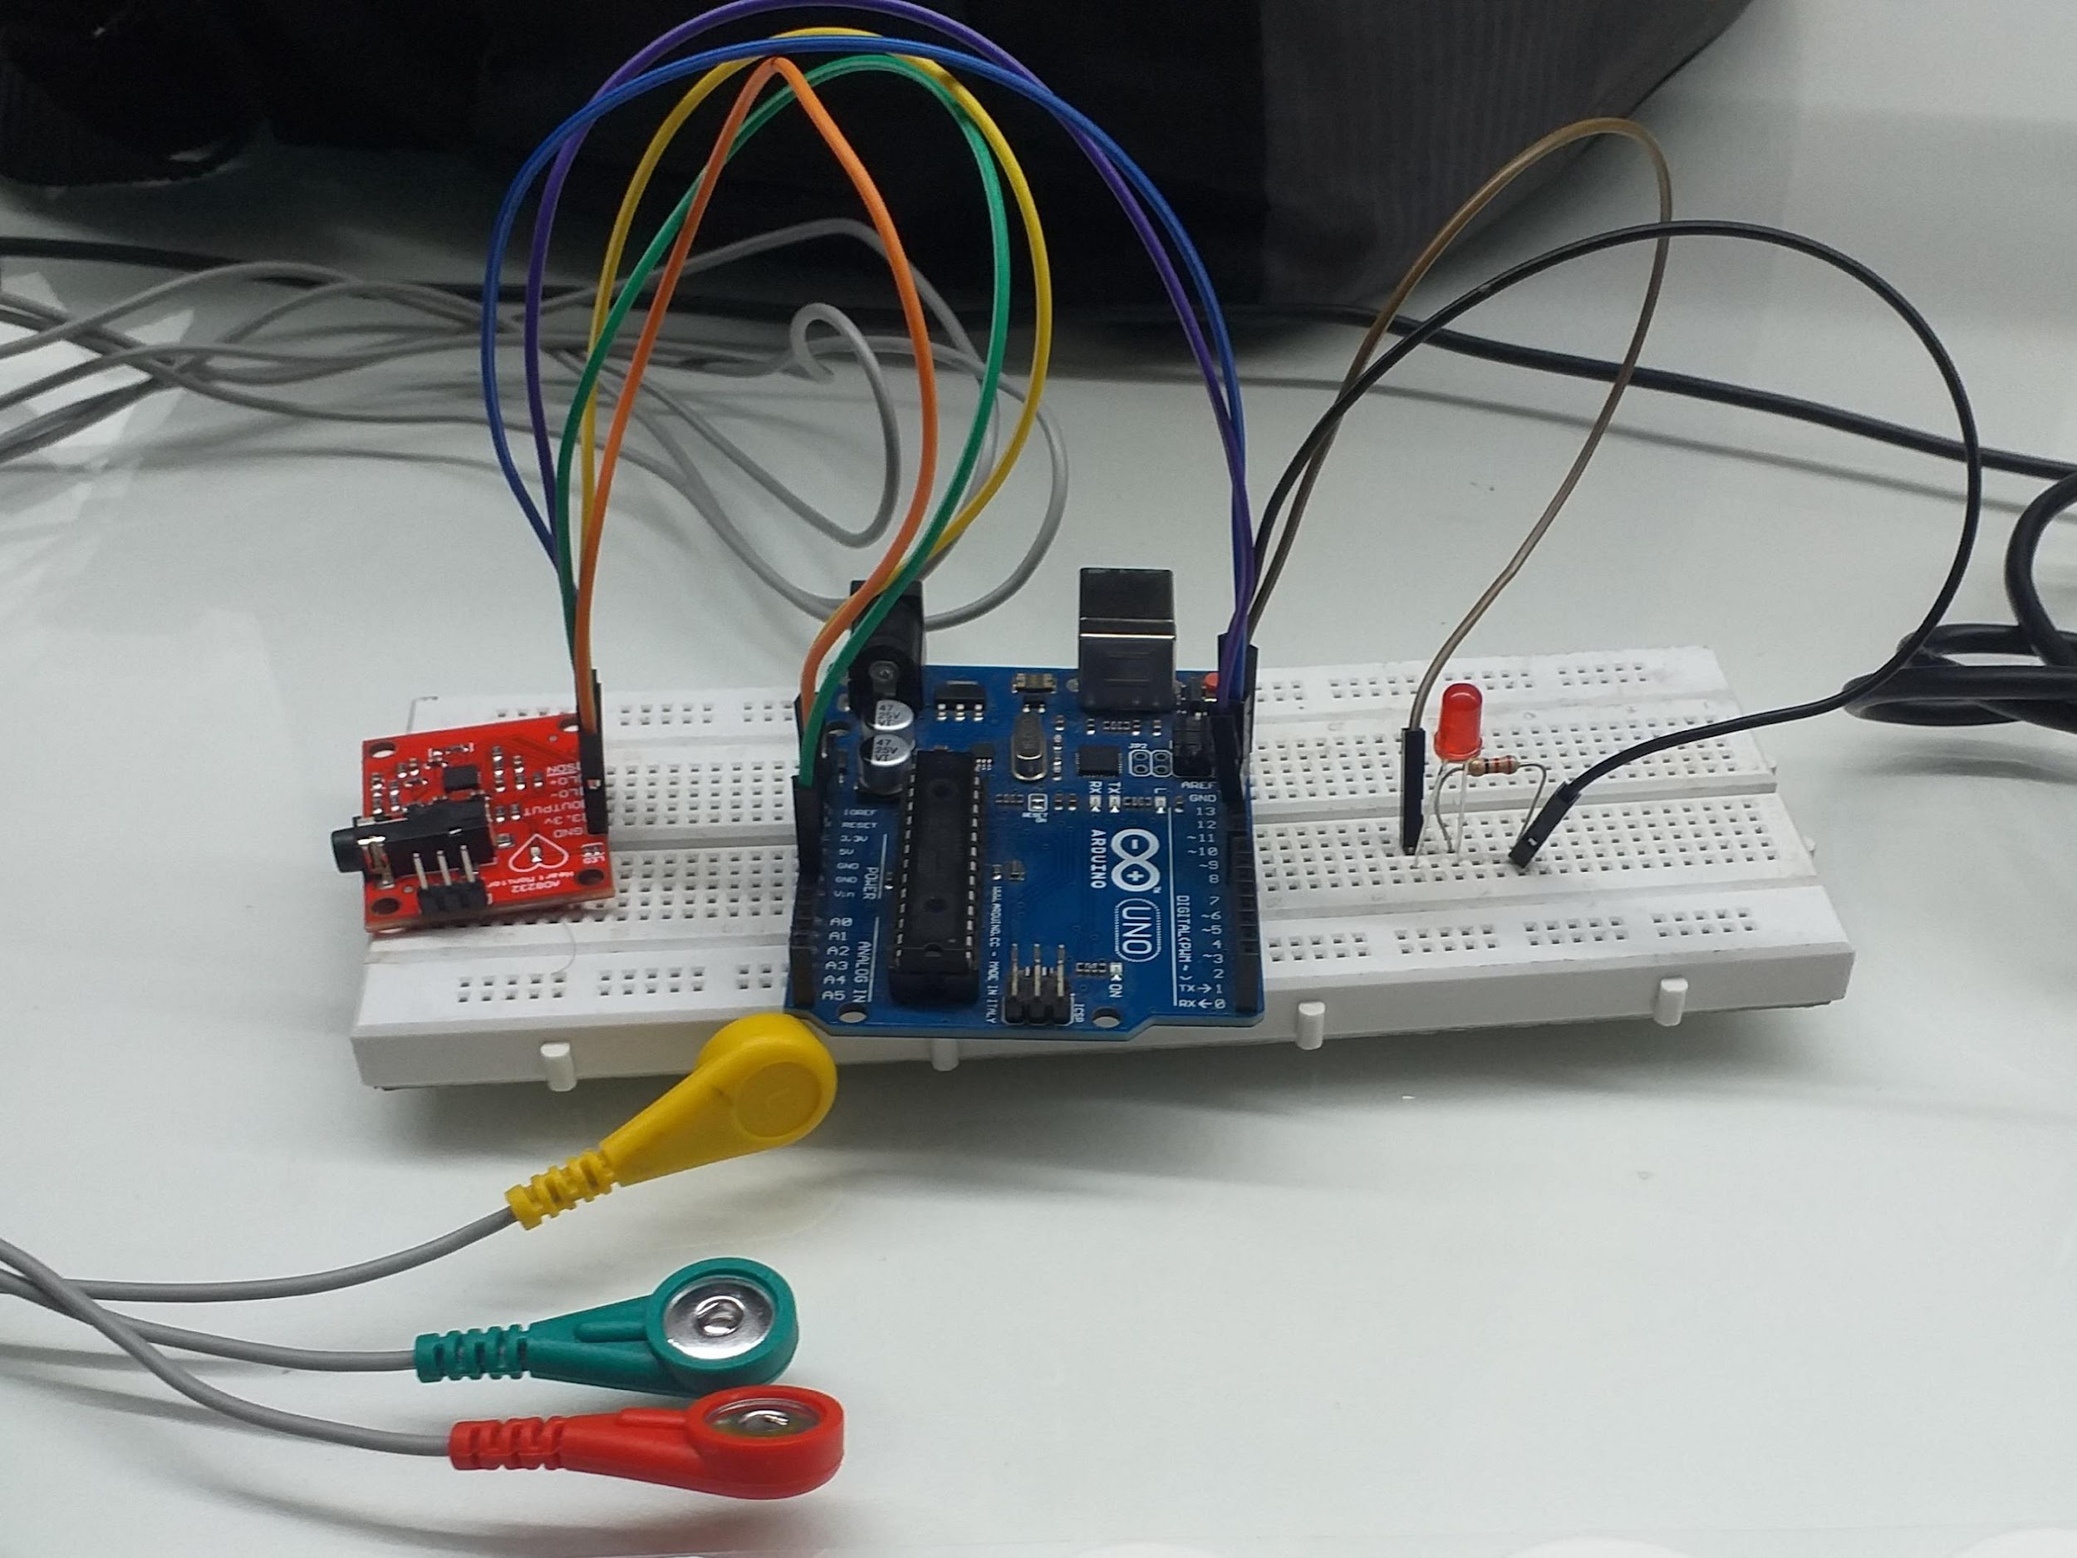
The setup -
This handy, cost effective heart monitoring device consists of :
Arduino Uno,
AD8232 ECG sensor
Electrodes
Red LED.

Slide 5
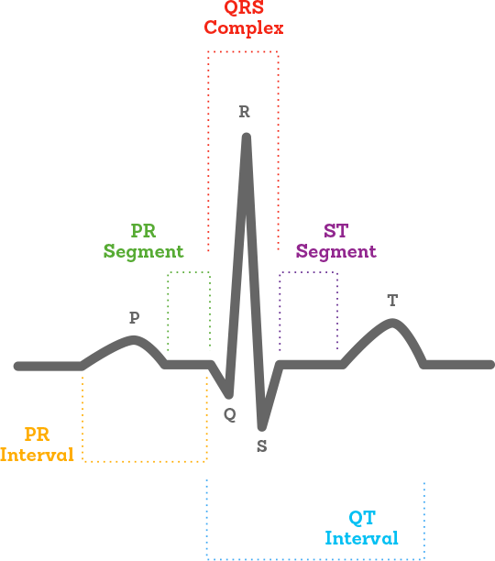
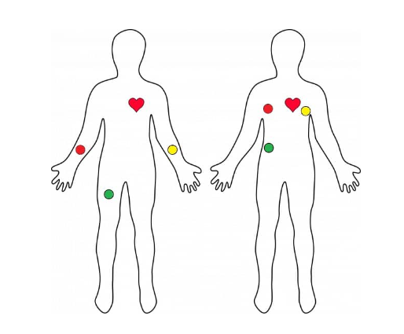
ECG electrode placement
Placement at chest is preferred for accurate results.

Slide 6
The working
After placing the electrodes, the LED turns on, indicating the sensor is reading ECG and when sufficient data is collected, the LED turns off.
The Pan Tomkins algorithm, detects the QRS segment from the raw ECG data and finds QRS width, which is an important parameter indicating various heart conditions like, Right Bundle Branch Block, Left Bundle Branch Block, Ventricular Arrythmias etc.
Heart rate and Heart rate variability is calculated with the formulae,
Heart rate = Length of RR interval * 60 / time duration
Heart rate variability = Root Mean Square of Successive Differences between each heartbeat.
Heart rate parameter helps in assessing 2 important heart conditions – Tachycardia and Bradycardia

Slide 7
The Working
The ECG graph and all the three parameters, the QRS width, Heart rate, Heart rate variability are published to the cloud.
In case of improper/suspicious reading, the cloud sends an alert mail, to the concerned persons indicating what parameter is unusual, what it might lead to etc.
Hence its a good system to keep track of various heart conditions of a person.

Slide 8
How is ECG data analysed?
The raw ECG data taken is processed with Pan Tomkins algorithm. The Pan–Tompkins algorithm is commonly used to detect QRS complexes in electrocardiographic signals. The QRS complex represents the ventricular depolarization and the main spike visible in an ECG signal.
This feature makes it particularly suitable for measuring heart rate, the first way to assess the heart health state.
Thus Heart rate and QRS width is calculated with the accuracy 99.3 percent
Source: Wikipedia https://en.wikipedia.org/wiki/Pan%E2%80%93Tompkins_algorithm#:~:text=The%20algorithm%20was,was%20correctly%20detected

Slide 9
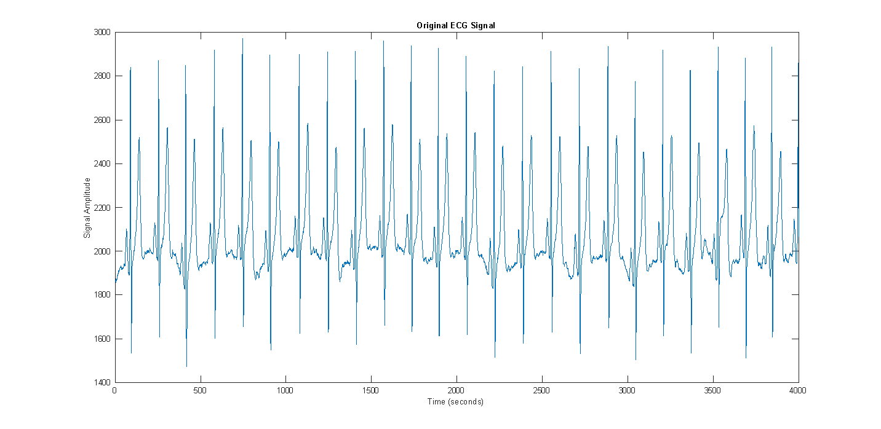
Raw ECG collected by placing at chest

Slide 10
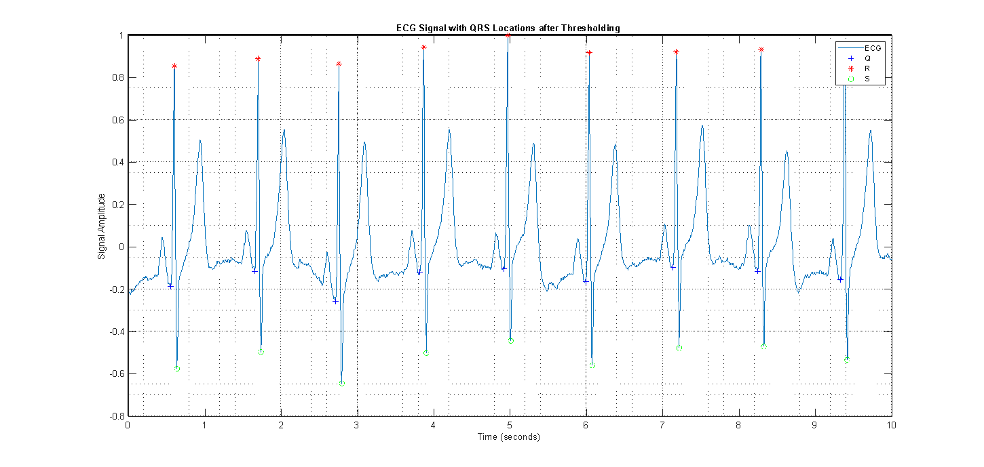
ECG Signal with QRS Locations after thresholding

Slide 11
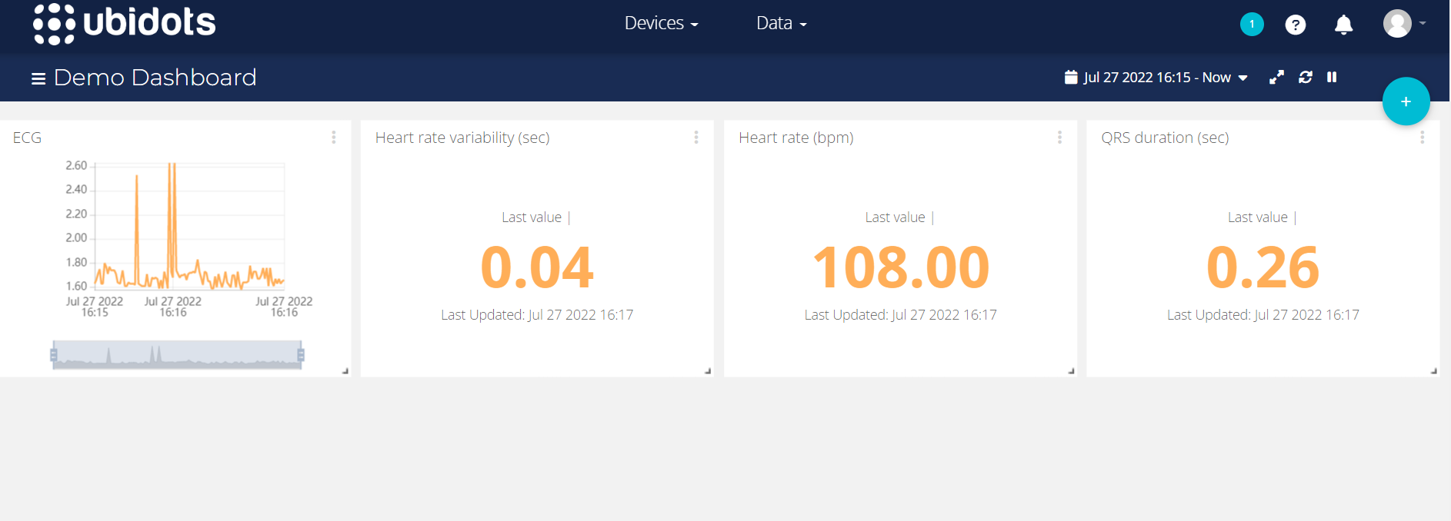
The Dashboard

Slide 12
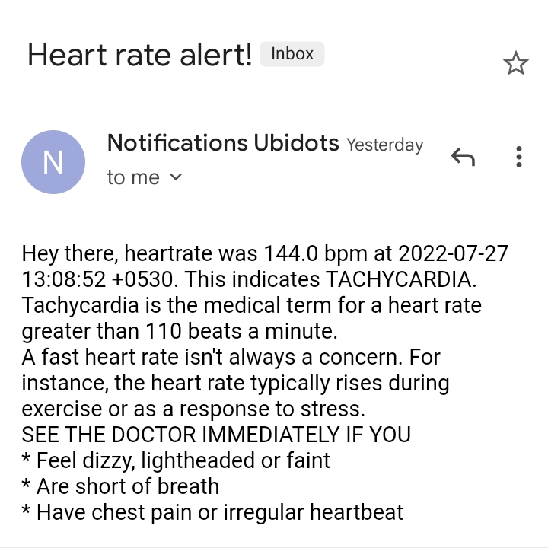
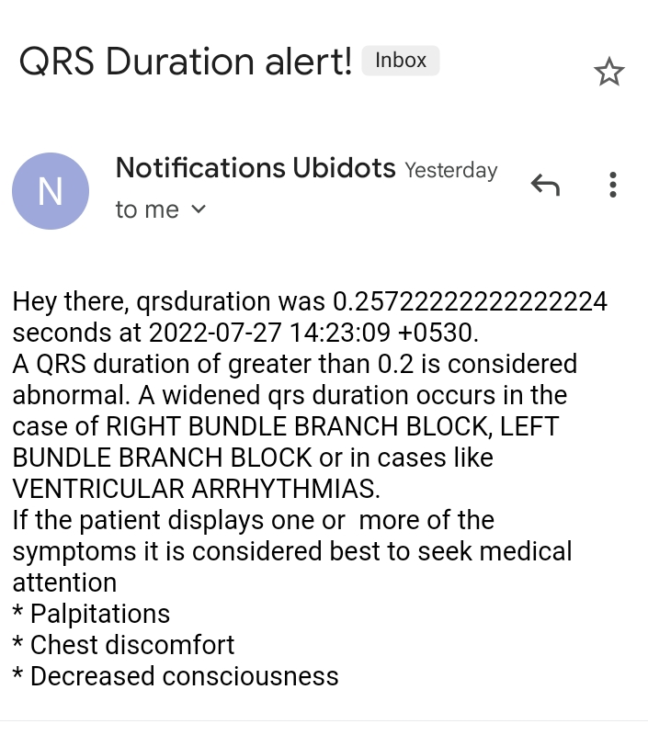
Various Alert Messages sent to the user

